Slide 1

Classification
Logistic
Regression
Machine Learning
Slides from CS-229 by Andrew Ng

Slide 2

Classification
Email: Spam / Not Spam?
Online Transactions: Fraudulent (Yes / No)?
Tumor: Malignant / Benign ?
0: “Negative Class” (e.g., benign tumor)
1: “Positive Class” (e.g., malignant tumor)

Slide 3

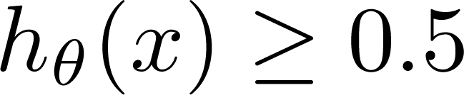
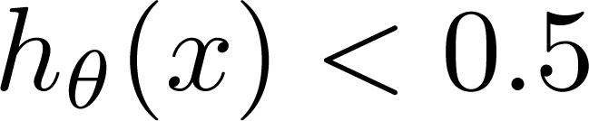
(Yes) 1
Malignant ?
(No) 0
Tumor Size
Tumor Size
Threshold will have to be changed because of these new points
Threshold classifier output at 0.5:
If , predict “y = 1”
If , predict “y = 0”

Slide 4

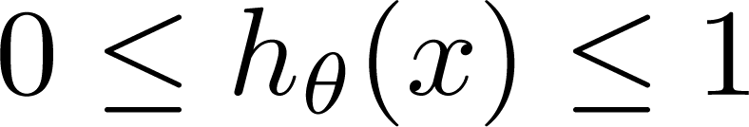
Classification: y = 0 or 1
can be > 1 or < 0
Logistic Regression:

Slide 5
Hypothesis Representation
Logistic
Regression
Machine Learning

Slide 6
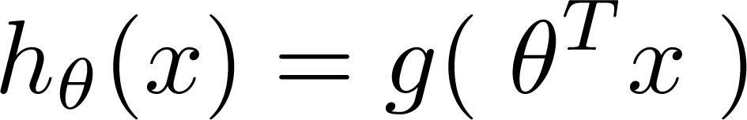
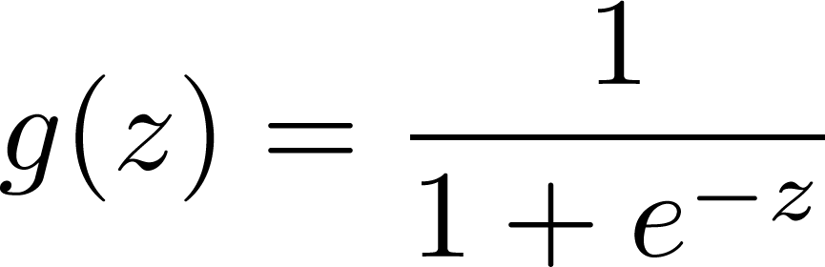
Logistic Regression Model
Want
1
0.5
Sigmoid function
Logistic function
0

Slide 7

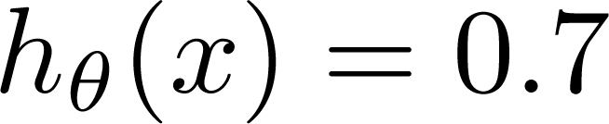
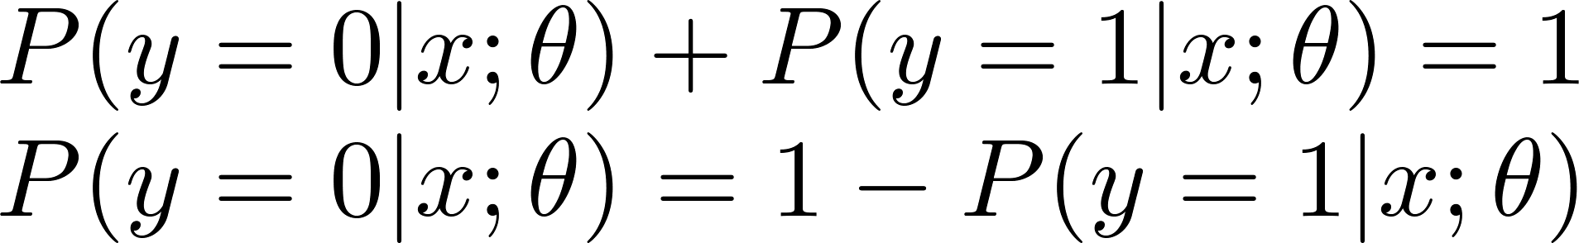
Interpretation of Hypothesis Output
= estimated probability that y = 1 on input x
Example: If
Tell patient that 70% chance of tumor being malignant
“probability that y = 1, given x,
parameterized by ”

Slide 8
Decision boundary
Logistic
Regression
Machine Learning

Slide 9


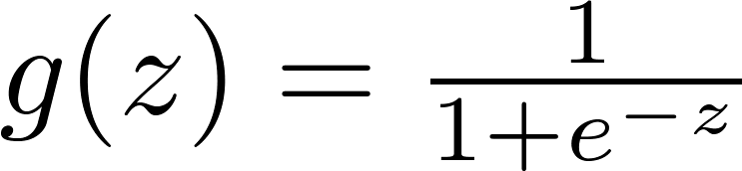

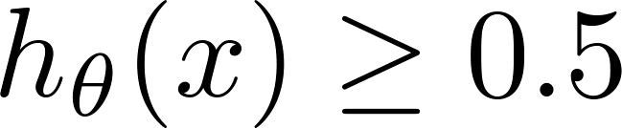

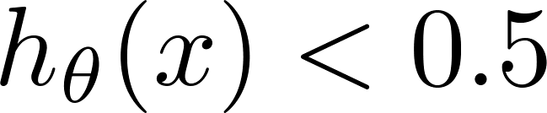



Logistic regression
1
0.5
$$0$$
z
Suppose predict “ “ if
Alternatively, if
$$z≥0; θ^{T}x ≥0$$
predict “ “ if
Alternatively, if
$$z<0; θ^{T}x<0$$

Slide 10
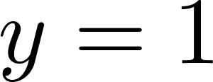




Decision Boundary
x₂
Linear decision boundary
3
2
1
Predict “ “ if
$$θ^{T}x ≥0$$
1
2
3
x₁
Suppose $θ_{0}=−3, θ_{1}=1, θ_{2}=1$
Predict “ “ if
$$x_{1}+ x_{2}≥3$$

Slide 11
Cost function
Logistic
Regression
Machine Learning

Slide 12
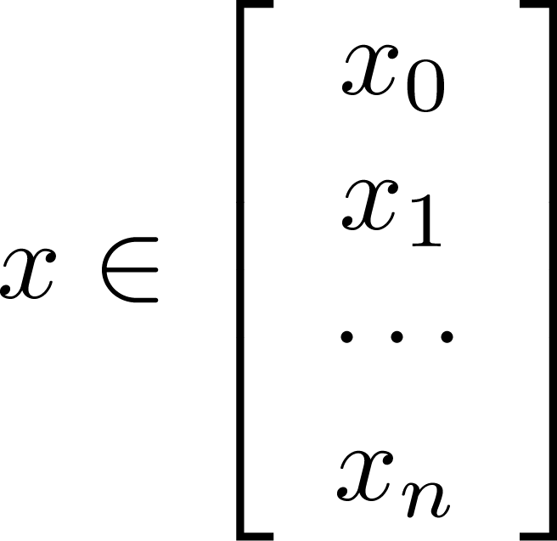

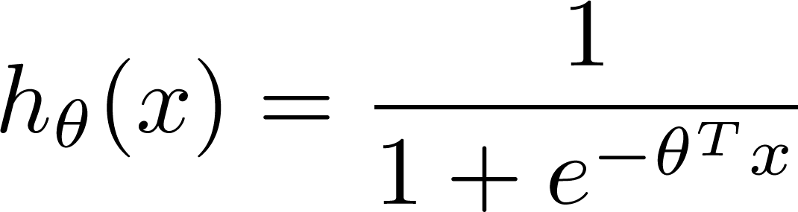

Training set:
m examples
How to choose parameters ?

Slide 13
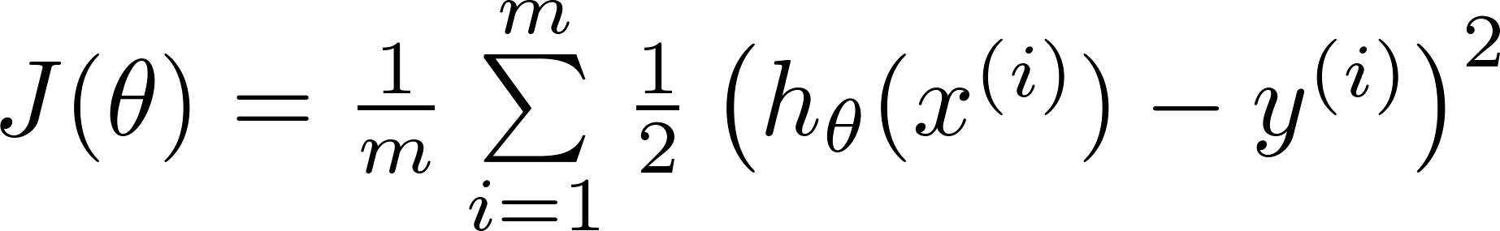

Cost function
Linear regression:
“non-convex”
“convex”

Slide 14
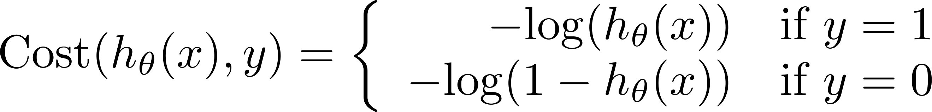
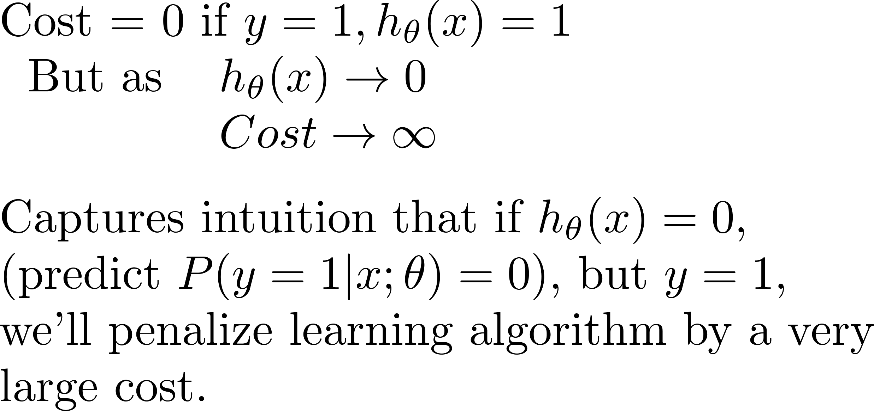
Logistic regression cost function
If y = 1
0
1

Slide 15
Logistic regression cost function
If y = 0
0
1

Slide 16
Simplified cost function
Logistic
Regression
Machine Learning

Slide 17
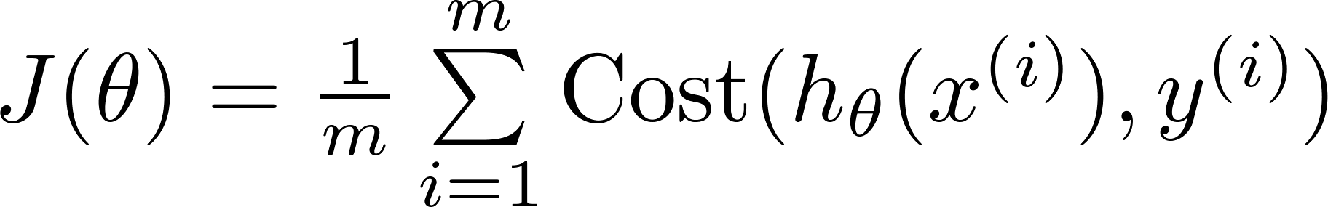
Logistic regression cost function
$$Cost\left(h_{θ\left(x\right)},y\right)=−ylog\left(h_{θ}\left(x\right)\right) −\left(1−y\right)log⁡(1−h_{θ}\left(x\right))$$

Slide 18



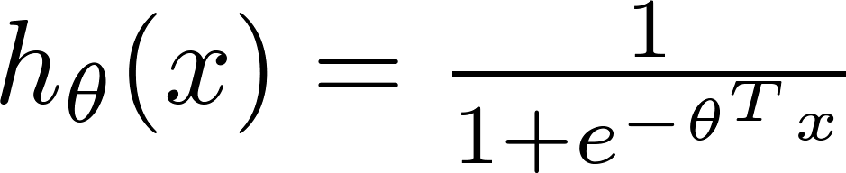
Logistic regression cost function
To fit parameters :
To make a prediction given new :
Output

Slide 19


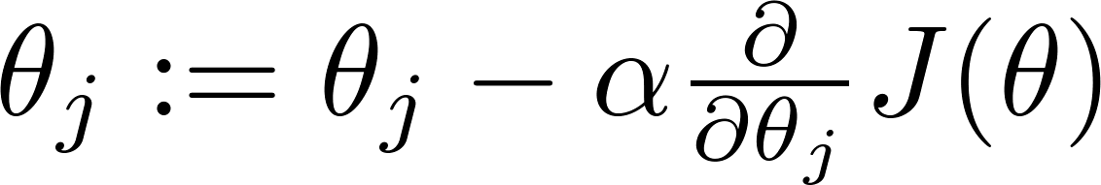


Gradient Descent
Want :
Repeat
(simultaneously update all )

Slide 20
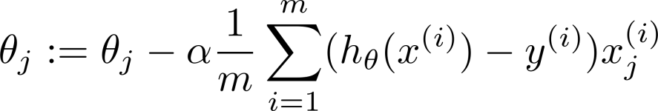
Gradient Descent
Want :
Repeat
(simultaneously update all )
Algorithm looks identical to that of linear regression!
What’s the difference then?

Slide 21
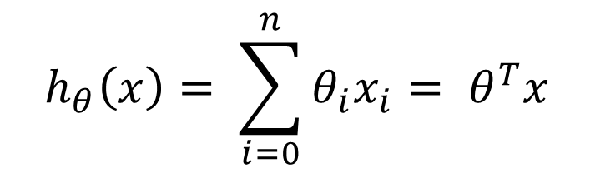
Recall
Linear regression:
$$h_{θ}\left(x\right)= \sum_{i=0}^{n}{θ_{i}x_{i}= θ^{T}x}$$
Logistic regression:

Slide 22

Gradient Descent
Want :
Repeat
(simultaneously update all )
Algorithm looks identical to that of linear regression!
The hypothesis has changed now!
$$h_{θ}\left(x\right)$$

Slide 23
Logistic Regression (Binary Classification)
Want :
Repeat
(simultaneously update all )
How to extend for multi-class classification?

Slide 24
Multi-class classification: One-vs-all
Logistic
Regression
Machine Learning

Slide 25
Multiclass classification
Email tagging: Work, Friends, Family, Hobby, etc.
Medical diagrams: Not ill, Cold, Flu, etc.
Weather: Sunny, Cloudy, Rain, Snow, etc.
Images: Cat, Table, Person, etc.

Slide 26
Binary classification:
Multi-class classification:
x₂
x₂
x₁
x₁

Slide 27
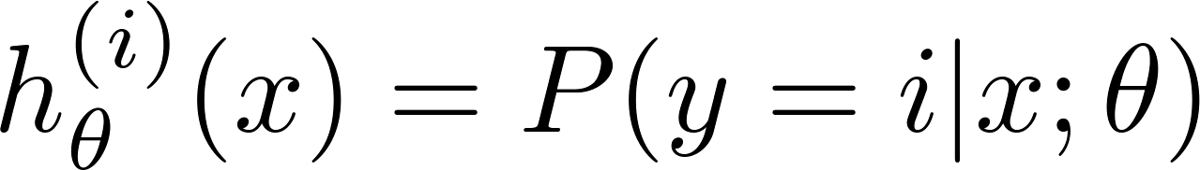

x₂
One-vs-all (one-vs-rest):
x₁
x₂
x₂
x₁
x₁
Class 1:
Class 2:
Class 3:
x₂
x₁

Slide 28
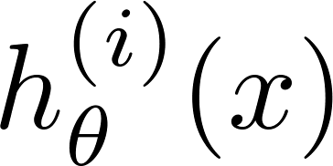

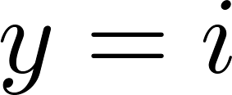
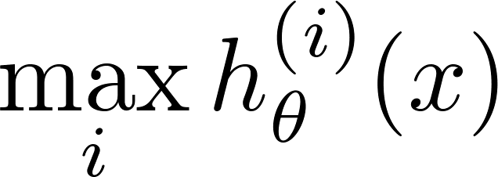
One-vs-all
Train a logistic regression classifier for each class to predict the probability that .
On a new input , to make a prediction, pick the class that maximizes

